Slide 1

CS 623 Cloud Computing Final Project
Smart EV Charging Reservation Platform
AWS Cloud Integration Architecture
Student: Inderpal Singh
Professor: Babak Esmaeili
Institution: California State University, East Bay
Date: June 2026

Slide 2


MARKET CONTEXT & NEED
Meeting the Demand
As the global transition to electric mobility accelerates, the reliability of charging infrastructure becomes critical.
Rising need for seamless reservation systems
Scalability requirements for peak-hour demands
Shift from on-premise to serverless cloud models

Slide 3

PROJECT OBJECTIVES
→
Frontend-Cloud Synergy: Enable direct communication between React and AWS.
Core Vision
→
Resource Management: Dynamic selection of available charging stations.
Develop a robust, cloud-native reservation platform demonstrating high-fidelity integration between frontend interfaces and AWS backend services.
→
Persistent Storage: Secure and scalable data persistence using DynamoDB.
→
Architecture Validation: End-to-end testing of the serverless request-response cycle.

Slide 4






PLATFORM CAPABILITIES
Reservation Entry
Station Selection
Cloud Submission
Intuitive React interface for users to input reservation details including timing and duration.
Users select an available charging station from the reservation interface.
Instant synchronization of local state with the AWS cloud persistence layer via secure APIs.

Slide 5

THE TECHNOLOGY STACK

Slide 6
SYSTEM WORKFLOW
User Interface
API Layer
Processing
Persistence
Response
User interacts with React Frontend
Request sent to AWS API Gateway
Lambda executes logic & validation
Data stored in DynamoDB table
Success confirmation sent back

Slide 7

AWS API GATEWAY
The Digital Entry Point
Acts as the secure "front door" for applications to access backend data and business logic.
Public RESTful API Endpoint
Frontend-to-Backend Orchestration
Request Routing and Transformation

Slide 8
SERVERLESS COMPUTING
AWS Lambda Integration
Event-driven compute service that runs code only when triggered by API requests.
0
Automated Logic: Generates unique Reservation IDs per request.
Stateless Execution: High-performance data processing for reservations.
SERVERS TO MANAGE
Seamless Storage: Direct integration with DynamoDB SDK.

Slide 9

SCALABLE DATA STORAGE
DynamoDB Service Role
Feature | Implementation Role
Type | NoSQL Key-Value Store
Latency | Single-digit Millisecond
Scaling | On-demand Capacity
Role | Persistence Layer

Slide 10
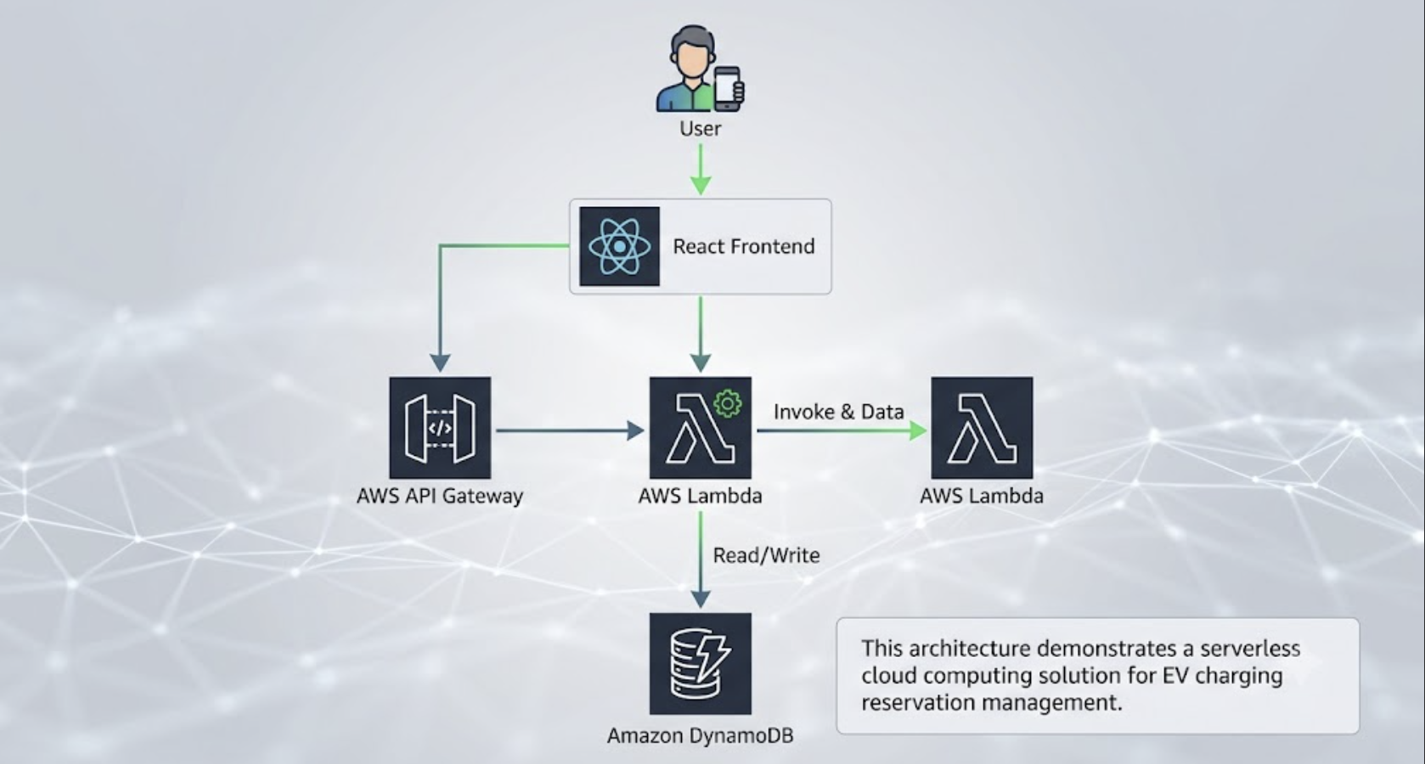
DEMONSTRATION WORKFLOW
1 Open App: Launch the React application in the browser.
2 Input: Enter reservation time and station details.
3 Submit: Click reserve to trigger the cloud pipeline.
4 API Hook: Gateway receives and routes the POST request.
5 Compute: Lambda processes data and adds a timestamp/ID.
6 Store: Record is permanently added to the DB.
7 Verify: Cross-check record in AWS Management Console.

Slide 11
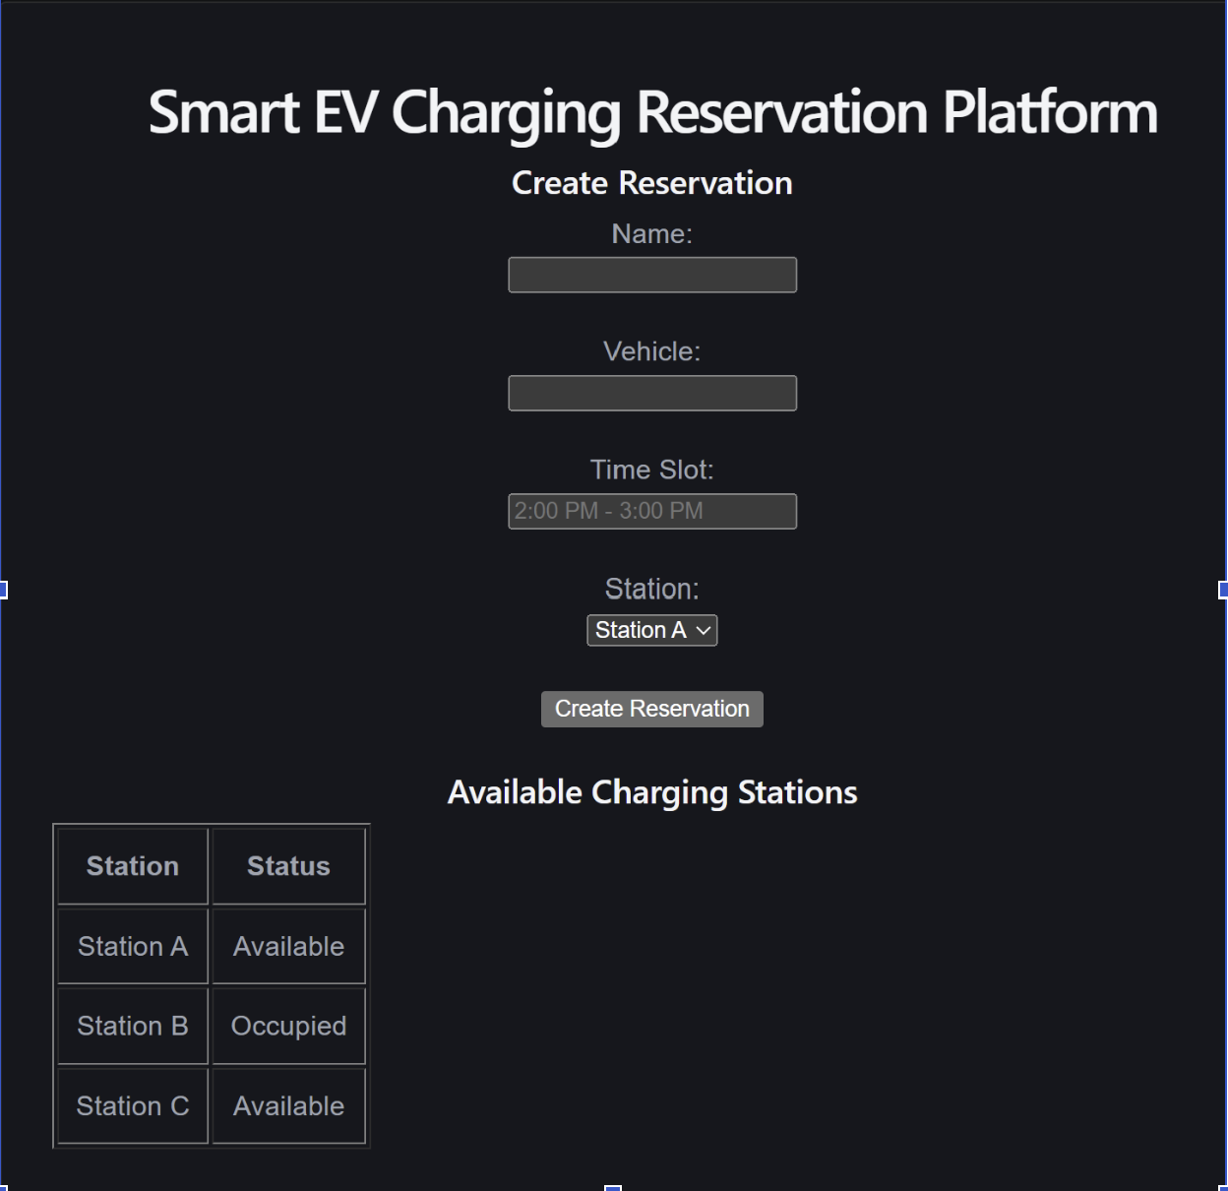
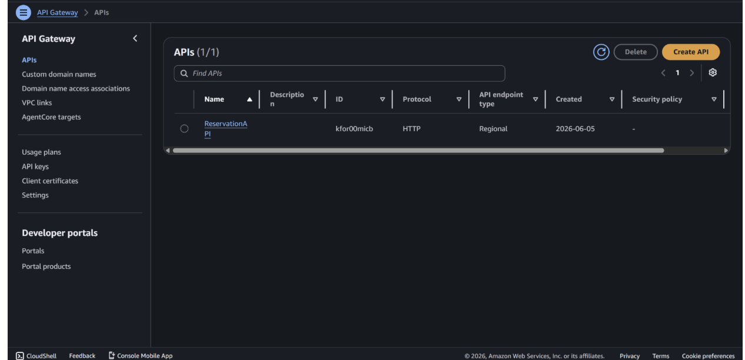



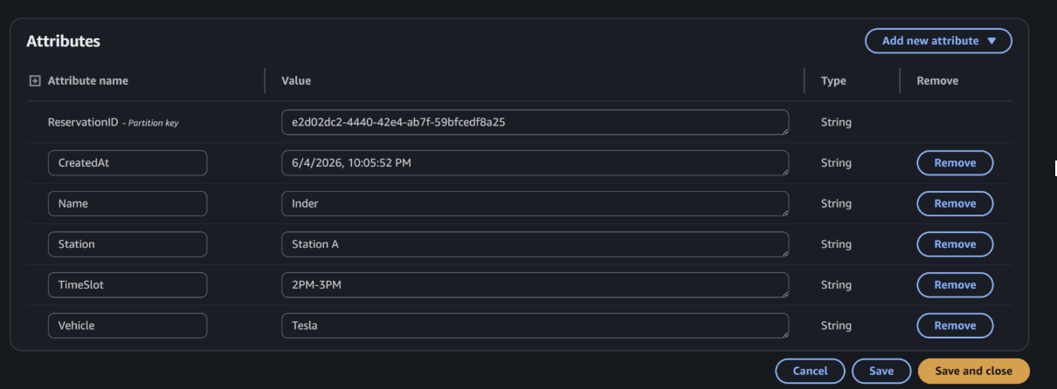
SYSTEM VALIDATION PROOFS
Frontend Logic
Cloud Pipeline
AWS API Gateway & Lambda Integration
Live Record
React Form Validation
DynamoDB Reservation Record

Slide 12













FUTURE ENHANCEMENTS
AWS Cognito Auth
Stripe Payment Gateway
Integrate seamless and secure sign-up, sign-in, and access control with multi-factor authentication.
Process quick and safe cashless transaction handling for booking charging sessions directly.
Dynamic Availability
Reservation Cancellation
Optimize resource management with live smart scheduling updates and sensor integrations.
Allow automated booking refunds, slot releases, and real-time waiting list updates.
Real-Time Analytics Dashboard
Monitor charger utilization rates, active user session patterns, and financial performance telemetry via intuitive data pipelines.

Slide 13

Thank You
Questions & Discussion
Cloud Computing Final Project | CS 623
Inderpal Singh | California State University, East Bay

Slide 14





IMAGE SOURCES
https://static.vecteezy.com/system/resources/thumbnails/060/030/869/small/a-modern-mobility-hub-illuminated-by-vibrant-neon-lights-hosts-multiple-automated-charging-stations-for-electric-vehicles-at-night-highlighting-innovations-in-transportation-and-electrification-photo.jpg
Source: www.vecteezy.com
https://media.istockphoto.com/id/1665910516/photo/cloud-and-edge-computing-technology-data-transfer-concept-a-large-cloud-icon-is-in-the-center.jpg?s=612x612&w=0&k=20&c=v37ipYB5w6g47pk9bv1b0hcRJBuiyJ7X_WE2q8OEW8o=
Source: www.istockphoto.com
https://symbols.getvecta.com/stencil_261/6_aws-dynamodb.58cd32ddb8.svg
Source: vecta.io
https://www.designstudiouiux.com/static/dd66435720c8159606957d37d50a1c17/ac8a3/Web-App-Design-GUide_Featured.jpg
Source: www.designstudiouiux.com
https://squaredup.com/_next/image/?url=https%3A%2F%2Fcdn.sanity.io%2Fimages%2Fz7wg6mcy%2Fproduction-2025%2F25f2b05c4ddc5e93f55af8086f2adfa5cf13a016-975x549.png&w=3840&q=75
Source: squaredup.com

